Slide 1
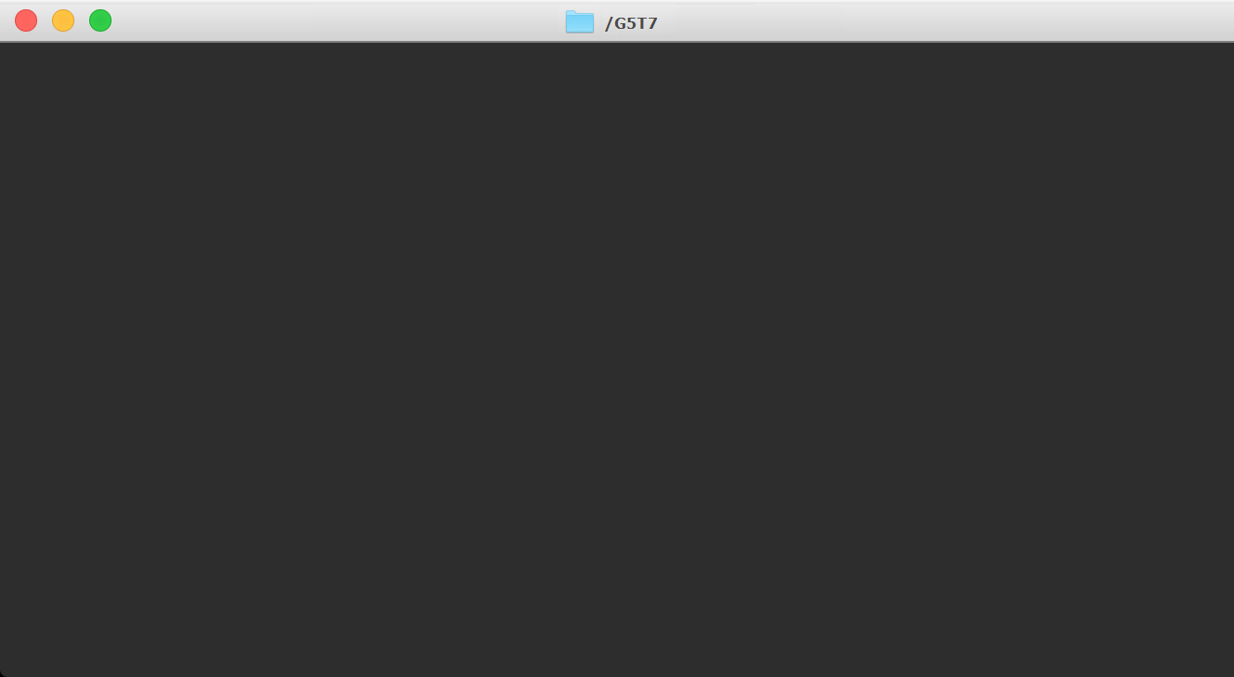















Kwek Jian Yong, Kenny - IT Operations Manager & Support Manager
Key Features of Environment
Load Balanced
Ability to mitigate XSSjacking & clickjacking attacks
Wide range of monitoring tools including Nagios
AWS Alarms
Nightly AMI Backup
I’ve learnt about the complexity of keeping an Enterprise System alive. I believe the process and tools learnt during this course will be useful in my future career. Expecting and planning for possible disasters is crucial to ensure business continuity
Cloudtopus,
HTOP, VisualPing, FreshPing
Workload & Deadline Management
Workload & Deadline Management
Graphics Design
Ong De Lin- Quality Assurance
This course has taught me management skills on how to manage and sustain my system. It also taught me that it is important not to be complacent and always find ways to automate certain processes to make our life easier.
Milestones
Zero-downtime achieved during Deployment Week
Website ran continuously when Port 8000 was down as website was load-balanced with additional ports
Successfully performed SCP Update and Security change requests
Dealt with Wannacry Attack successfully and provided advice regarding Fantasma Web Services
Weekly Risk Matrix
Quality Assurance
Nightly AMI
Backup
Lee Jia Ern, Janell- Tier 1 Communications Manager
I have learnt that as a whole, the voices of customers, employees and management should be considered in order to encourage collaboration in improving the company’s services and contribute to the success of the business as the goal.
Process
Workflow
User Communication
Ticket Support
Tan Rong Jian Mark- Tier 2 Business Analyst
Business Value Added
Increased efficiency in dealing with business issues
Ensure that the site/app configuration files are automatically backed up regularly
Provided comprehensive monitoring tools
Measures to ensure users can access website without disruptions/security issues
Documentations are consistently maintained to ensure quality control
Ensure business does not have recurring incidents
I have learnt how to manage an Enterprise System and what goes behind the scenes to monitor and keep the system running. In addition, I had the opportunity to learn more about popular tools and softwares such as AWS and Nagios.
AWS Management
Business Process Management
Nagios
Lau Jun Rong- Tier 3 Development and Infrastructure & Security
ESM has taught me the importance of deploying and managing the systems. It requires a lot of experience to get things right and in place.
Gunicorn Dual Port Setup (Load Balancer)
Security Advisory
DNS Management

